Slide 1



Query-Specific KGs for Complex Finance Topics
Iain Mackie, Jeffrey Dalton
AKBC 2022 Workshop, Knowledge Graphs in Finance and Economics
Github: github.com/grill-lab/akbc-finance-kgs
Twitter: @iain_with_2is, @JeffD

Slide 2








Little background about myself…
Quant Trading
Investment Management
Venture Capital
Applied Economics MA
Data Science MSc
Information Retrieval PhD
Alexa Challenge
2010
2014
2017
2019
2022

Slide 3
Finance research
Trading, Investment, VC researchers answer complex questions
“Search” for relevant information and “reason” a knowledge-grounded long-form answer

Slide 4

Finance research
Trading, Investment, VC researchers answer complex questions
“Search” for relevant information and “reason” a knowledge-grounded long-form answer
Question
How is the push towards electric cars impacting the demand for raw materials?

Slide 5
Finance research
Trading, Investment, VC researchers answer complex questions
“Search” for relevant information and “reason” a knowledge-grounded long-form answer
Question
How is the push towards electric cars impacting the demand for raw materials?
Heterogeneous Sources

Slide 6
Finance research
Trading, Investment, VC researchers answer complex questions
“Search” for relevant information and “reason” a knowledge-grounded long-form answer
16105186
Electric car
Question
3e90ee1ba8cde7c9cc74f5ede4d3ea1c
The batteries for EVs and the emerging energy storage market will drive up demand for lithium, nickel and cobalt.
How is the push towards electric cars impacting the demand for raw materials?
24580536
Cobalt
4780974
Demand
3fd69e144d8b2adc3684eff2d06c79c3
This year alone, demand for cobalt could increase 40-50%, with use in the battery sector alone exploding
15-20-fold by 2030.
Heterogeneous Sources

Slide 7

Finance research
Trading, Investment, VC researchers answer complex questions
“Search” for relevant information and “reason” a knowledge-grounded long-form answer
16105186
Electric car
Question
3e90ee1ba8cde7c9cc74f5ede4d3ea1c
The batteries for EVs and the emerging energy storage market will drive up demand for lithium, nickel and cobalt.
How is the push towards electric cars impacting the demand for raw materials?
24580536
Cobalt
4780974
Demand
3fd69e144d8b2adc3684eff2d06c79c3
This year alone, demand for cobalt could increase 40-50%, with use in the battery sector alone exploding
15-20-fold by 2030.
Heterogeneous Sources
Document

Slide 8
But there’s a problem…
This is a hard task
SOTA ranking models struggle with this category of queries [1]
Non-factoid, multi-faceted, long answer type, multi-hop reasoning
Factual accuracy of LLM long-form text generation
Hallucination, attribution, scale of context, retrieval performance
[1] Iain Mackie, Jeffrey Dalton, Andrew Yates. How Deep is your Learning: the DL-HARD Annotated Deep Learning. SIGIR 2021.

Slide 9
But there’s a problem…
This is a hard task
SOTA ranking models struggle with this category of queries [1]
Non-factoid, multi-faceted, long answer type, multi-hop reasoning
Factual accuracy of LLM long-form text generation
Hallucination, attribution, scale of context, retrieval performance
…And we don’t have a dataset!
Complex domain-specific questions
High-quality judgments
Document relevance
Entity relevance
Long-form answer
[1] Iain Mackie, Jeffrey Dalton, Andrew Yates. How Deep is your Learning: the DL-HARD Annotated Deep Learning. SIGIR 2021.

Slide 10
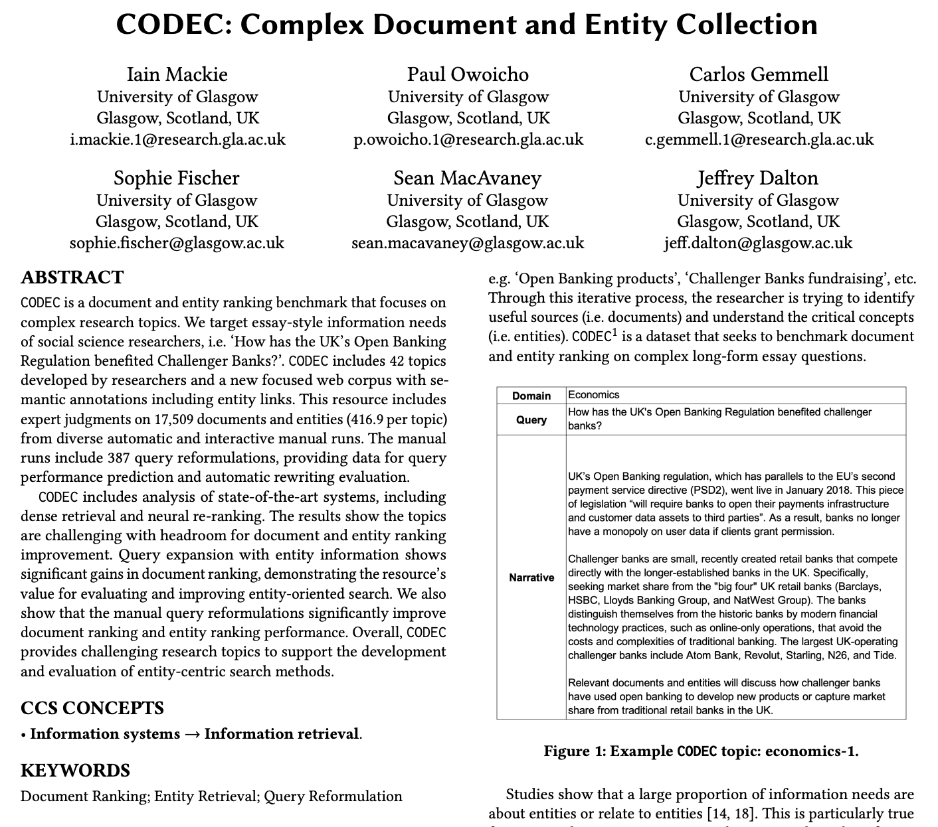
CODEC: Complex Document and Entity Collection
[2] Iain Mackie, Paul Owoicho, Carlos Gemmell, Sophie Fischer, Sean MacAvaney, and Jeffrey Dalton. CODEC: Complex Document and Entity Collection. SIGIR 2022.

Slide 11
CODEC: Complex Questions
Domain experts
Trader, Investment Banker, Accountant
Researcher
[2] Iain Mackie, Paul Owoicho, Carlos Gemmell, Sophie Fischer, Sean MacAvaney, and Jeffrey Dalton. CODEC: Complex Document and Entity Collection. SIGIR 2022.

Slide 12
CODEC: Complex Questions
Domain experts
Trader, Investment Banker, Accountant
Researcher
Complex Criteria
Open-ended essay-style
Natural language query
Multiple points of view
Concern multiple entities
Requires domain knowledge
[2] Iain Mackie, Paul Owoicho, Carlos Gemmell, Sophie Fischer, Sean MacAvaney, and Jeffrey Dalton. CODEC: Complex Document and Entity Collection. SIGIR 2022.

Slide 13
CODEC: Complex Questions
Domain experts
Trader, Investment Banker, Accountant
Researcher
Complex Criteria
Question
Open-ended essay-style
Natural language query
Multiple points of view
Concern multiple entities
Requires domain knowledge
How is the push towards electric cars impacting the demand for raw materials?
[2] Iain Mackie, Paul Owoicho, Carlos Gemmell, Sophie Fischer, Sean MacAvaney, and Jeffrey Dalton. CODEC: Complex Document and Entity Collection. SIGIR 2022.

Slide 14
CODEC: Long-Form Answers
Domain experts
Trader, Investment Banker, Accountant
Complex Question
How is the push towards electric cars impacting the demand for raw materials?
[2] Iain Mackie, Paul Owoicho, Carlos Gemmell, Sophie Fischer, Sean MacAvaney, and Jeffrey Dalton. CODEC: Complex Document and Entity Collection. SIGIR 2022.

Slide 15
CODEC: Long-Form Answers
Domain experts
Trader, Investment Banker, Accountant
Complex Question
Researcher
How is the push towards electric cars impacting the demand for raw materials?
[2] Iain Mackie, Paul Owoicho, Carlos Gemmell, Sophie Fischer, Sean MacAvaney, and Jeffrey Dalton. CODEC: Complex Document and Entity Collection. SIGIR 2022.

Slide 16
CODEC: Long-Form Answers
Domain experts
Trader, Investment Banker, Accountant
~144 words average
Complex Question
Researcher
Long-Form Answer
Mass adoption of electric vehicles (EVs) is expected in the years ahead. This shift has, and will continue to have, a significant impact on demand for specific raw materials. For example, lithium, nickel and cobalt will increase due to battery demand. While oil-based vehicles will decline in the coming decades, which will reduce the need for oil…
How is the push towards electric cars impacting the demand for raw materials?
[2] Iain Mackie, Paul Owoicho, Carlos Gemmell, Sophie Fischer, Sean MacAvaney, and Jeffrey Dalton. CODEC: Complex Document and Entity Collection. SIGIR 2022.

Slide 17
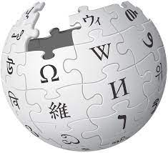




CODEC: Document + Entity Judgments
42x topics (14x finance)
Query: How is the push towards electric cars impacting the demand for raw materials?
Narrative: Mass adoption of electric vehicles (EVs) is expected in the years ahead…
5.9m entities
Entity
KB
Annotator
Document Corpus
730k documents
Notes:
We’d look at both types of possible systems failures
1st-pass retrieval (where we use recall@1000) and
2nd-pass re-ranking (where we use NDCG@10 to focus on top ranks)

Slide 18
CODEC: Document + Entity Judgments
42x topics (14x finance)
Query: How is the push towards electric cars impacting the demand for raw materials?
Narrative: Mass adoption of electric vehicles (EVs) is expected in the years ahead…
Manual query reformulation
5.9m entities
electric vehicles lithium, nickel and cobalt
electric vehicles shortage raw materials
electric cars battery on resources
impact of electric cars supply chain
electric cars and shift away from oil and gas
China and electric cars raw materials
Electric vehicles and Democratic Republic of Congo
Electric car and semiconductor shortage
How is the push towards electric cars impacting the demand for raw materials?
Entity
KB
300+ hours
Annotator
Interactive
Search
System
Document Corpus
730k documents
Notes:
We’d look at both types of possible systems failures
1st-pass retrieval (where we use recall@1000) and
2nd-pass re-ranking (where we use NDCG@10 to focus on top ranks)

Slide 19
CODEC: Document + Entity Judgments
42x topics (14x finance)
Query: How is the push towards electric cars impacting the demand for raw materials?
Narrative: Mass adoption of electric vehicles (EVs) is expected in the years ahead…
Manual query reformulation
5.9m entities
electric vehicles lithium, nickel and cobalt
electric vehicles shortage raw materials
electric cars battery on resources
impact of electric cars supply chain
electric cars and shift away from oil and gas
China and electric cars raw materials
Electric vehicles and Democratic Republic of Congo
Electric car and semiconductor shortage
How is the push towards electric cars impacting the demand for raw materials?
Entity
KB
300+ hours
Annotator
Interactive
Search
System
Judgment | Document Ranking | Entity Ranking
0 | 2,353 | 7,053
1 | 2,210 | 2,241
2 | 1,207 | 1,252
3 | 416 | 777
TOTAL | 6,186 | 11,323
Document Corpus
730k documents
Notes:
We’d look at both types of possible systems failures
1st-pass retrieval (where we use recall@1000) and
2nd-pass re-ranking (where we use NDCG@10 to focus on top ranks)

Slide 20
So why do we care about retrieval?
To develop high-quality query-specific KGs we need good search effectiveness
16105186
Electric car
3e90ee1ba8cde7c9cc74f5ede4d3ea1c
The batteries for EVs and the emerging energy storage market will drive up demand for lithium, nickel and cobalt.
24580536
Cobalt
4780974
Demand
3fd69e144d8b2adc3684eff2d06c79c3
This year alone, demand for cobalt could increase 40-50%, with use in the battery sector alone exploding
15-20-fold by 2030.
Notes:
We’d look at both types of possible systems failures
1st-pass retrieval (where we use recall@1000) and
2nd-pass re-ranking (where we use NDCG@10 to focus on top ranks)

Slide 21
So why do we care about retrieval?
To develop high-quality query-specific KGs we need good search effectiveness
Initial retrieval effectiveness (recall)
We need high-recall to capture relevant documents and entities
16105186
Electric car
3e90ee1ba8cde7c9cc74f5ede4d3ea1c
The batteries for EVs and the emerging energy storage market will drive up demand for lithium, nickel and cobalt.
24580536
Cobalt
4780974
Demand
3fd69e144d8b2adc3684eff2d06c79c3
This year alone, demand for cobalt could increase 40-50%, with use in the battery sector alone exploding
15-20-fold by 2030.
Notes:
We’d look at both types of possible systems failures
1st-pass retrieval (where we use recall@1000) and
2nd-pass re-ranking (where we use NDCG@10 to focus on top ranks)

Slide 22
So why do we care about retrieval?
To develop high-quality query-specific KGs we need good search effectiveness
Initial retrieval effectiveness (recall)
We need high-recall to capture relevant documents and entities
Relevance weighting (precision)
Important to priorities relevant information between “critical” vs “background”
4332425
Cobalt Networks
16105186
Electric car
3e90ee1ba8cde7c9cc74f5ede4d3ea1c
The batteries for EVs and the emerging energy storage market will drive up demand for lithium, nickel and cobalt.
24580536
Cobalt
3fd69e1rfwu4b2adc364eff2d06c79c3
Cobalt Networks was a maker of low-cost Linux-based servers and server appliances
4780974
Demand
3fd69e144d8b2adc3684eff2d06c79c3
This year alone, demand for cobalt could increase 40-50%, with use in the battery sector alone exploding
15-20-fold by 2030.
Notes:
We’d look at both types of possible systems failures
1st-pass retrieval (where we use recall@1000) and
2nd-pass re-ranking (where we use NDCG@10 to focus on top ranks)

Slide 23
System Analysis
nDGC@10
Notes:
We’d look at both types of possible systems failures
1st-pass retrieval (where we use recall@1000) and
2nd-pass re-ranking (where we use NDCG@10 to focus on top ranks)

Slide 24
System Analysis
2021 TREC DL Document Ranking
Headroom!
nDGC@10
Notes:
We’d look at both types of possible systems failures
1st-pass retrieval (where we use recall@1000) and
2nd-pass re-ranking (where we use NDCG@10 to focus on top ranks)

Slide 25
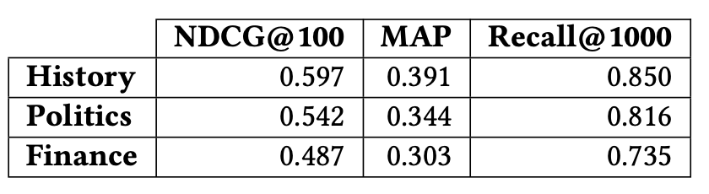
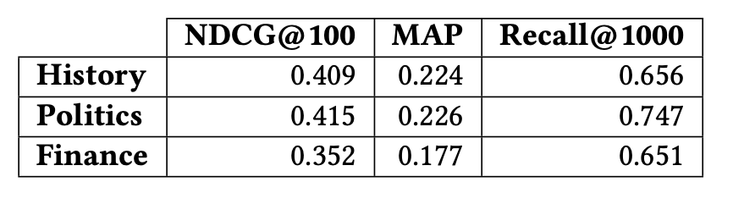
System Analysis – Domains
Document Ranking (BM25+RM3+T5)
Entity Ranking (BM25+RM3)
Notes:
We’d look at both types of possible systems failures
1st-pass retrieval (where we use recall@1000) and
2nd-pass re-ranking (where we use NDCG@10 to focus on top ranks)

Slide 26
System Analysis – Domains
Document Ranking (BM25+RM3+T5)
Finance is hard!
-> Effectiveness ~10-15% lower
Entity Ranking (BM25+RM3)
Notes:
We’d look at both types of possible systems failures
1st-pass retrieval (where we use recall@1000) and
2nd-pass re-ranking (where we use NDCG@10 to focus on top ranks)

Slide 27
System Analysis – Failures!
Was the crash that followed the dot-com bubble an overreaction considering the ultimate success of the internet?
What are the common problems or criticisms aimed at public sector enterprises?
What technological challenges does Bitcoin face to becoming a widely used
Notes:
We’d look at both types of possible systems failures
1st-pass retrieval (where we use recall@1000) and
2nd-pass re-ranking (where we use NDCG@10 to focus on top ranks)

Slide 28
System Analysis – Failures!
Unable to filter sources based on ‘event’ and ‘entity’
Was the crash that followed the dot-com bubble an overreaction considering the ultimate success of the internet?
Required latent knowledge
What are the common problems or criticisms aimed at public sector enterprises?
Miss core concepts [Transaction cost], [Carbon footprint], [Cyberattack] etc.
What technological challenges does Bitcoin face to becoming a widely used
Notes:
We’d look at both types of possible systems failures
1st-pass retrieval (where we use recall@1000) and
2nd-pass re-ranking (where we use NDCG@10 to focus on top ranks)

Slide 29
What if we connect the tasks?
Entity Linking
What if we connect both document ranking and entity ranking tasks using entity links
Entity
KB
5.9m entities
Document Corpus
Entity Linking
730k documents
Notes:
We’d look at both types of possible systems failures
1st-pass retrieval (where we use recall@1000) and
2nd-pass re-ranking (where we use NDCG@10 to focus on top ranks)

Slide 30
What if we connect the tasks?
Entity Linking
What if we connect both document ranking and entity ranking tasks using entity links
Free-text KG
Entity
KB
3e90ee1ba8cde7c9cc74f5ede4d3ea1c
The batteries for EVs and the emerging energy storage market will drive up demand for lithium, nickel and cobalt.
16105186
Electric car
5.9m entities
24580536
Cobalt
4780974
Demand
Document Corpus
Entity Linking
3fd69e144d8b2adc3684eff2d06c79c3
This year alone, demand for cobalt could increase 40-50%, with use in the battery sector alone exploding
15-20-fold by 2030.
730k documents
Notes:
We’d look at both types of possible systems failures
1st-pass retrieval (where we use recall@1000) and
2nd-pass re-ranking (where we use NDCG@10 to focus on top ranks)

Slide 31
What if we connect the tasks?
Entity Linking
And how does relevance of the two tasks relate?
Notes:
We’d look at both types of possible systems failures
1st-pass retrieval (where we use recall@1000) and
2nd-pass re-ranking (where we use NDCG@10 to focus on top ranks)

Slide 32
Entities → Document ranking
Entity Feedback
What if we connect both document ranking and entity ranking tasks?
Original Query
Entity Feedback
4780974
Demand
How is the push towards electric cars impacting the demand for raw materials?
16105186
Electric car
24580536
Cobalt
Document Corpus
Notes:
We’d look at both types of possible systems failures
1st-pass retrieval (where we use recall@1000) and
2nd-pass re-ranking (where we use NDCG@10 to focus on top ranks)

Slide 33
Entities → Document ranking
Entity Feedback
What if we connect both document ranking and entity ranking tasks?
Original Query
Entity Feedback
System Effectiveness
(BM25 example)
4780974
Demand
How is the push towards electric cars impacting the demand for raw materials?
16105186
Electric car
24580536
Cobalt
nDCG = +35%
MAP = +26%
Document Corpus
R@1000 = +12%
Notes:
We’d look at both types of possible systems failures
1st-pass retrieval (where we use recall@1000) and
2nd-pass re-ranking (where we use NDCG@10 to focus on top ranks)

Slide 34
A step further…Evaluate KG construction
Define the “golden graph” using CODEC
Document nodes: Relevant documents
Entity nodes: Relevant entities mentioned in relevant documents
Edges: Entity links between document and entity nodes (WAT entity linker)
Notes:
We’d look at both types of possible systems failures
1st-pass retrieval (where we use recall@1000) and
2nd-pass re-ranking (where we use NDCG@10 to focus on top ranks)

Slide 35
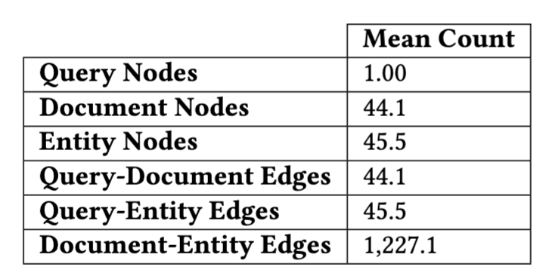
A step further…Evaluate KG construction
Define the “golden graph” using CODEC
Document nodes: Relevant documents ( + edge connecting to query)
Entity nodes: Relevant entities mentioned in relevant documents ( + edge connecting to query)
Edges: Entity links between document and entity nodes
Large ground-truth graphs!
Notes:
We’d look at both types of possible systems failures
1st-pass retrieval (where we use recall@1000) and
2nd-pass re-ranking (where we use NDCG@10 to focus on top ranks)

Slide 36
Automatic construction of topic-specific KGs
Using strong retrieval systems we can construct and evaluate topic-specific KGs
Document ranking: BM25+RM3+T5 (vary k_{doc} run depth)
Entity ranking: BM25+RM3 (vary k_{ent} run depth)
Notes:
We’d look at both types of possible systems failures
1st-pass retrieval (where we use recall@1000) and
2nd-pass re-ranking (where we use NDCG@10 to focus on top ranks)

Slide 37
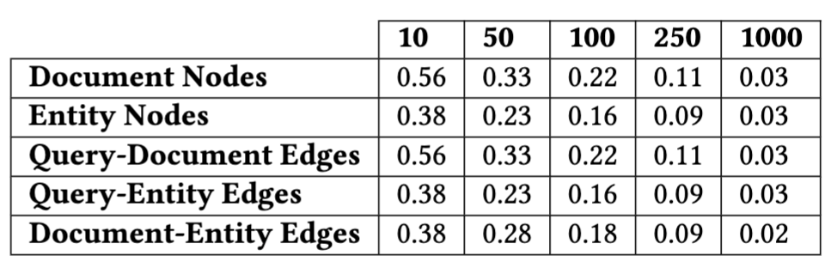
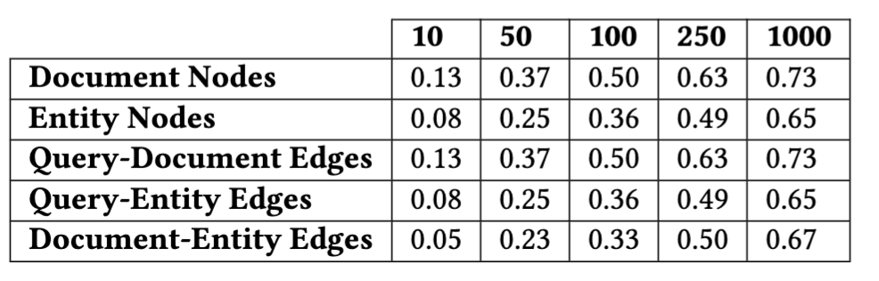
Automatic construction of topic-specific KGs
Using strong retrieval systems we can construct and evaluate topic-specific KGs
Document ranking: BM25+RM3+T5 (vary k_{doc} run depth)
Entity ranking: BM25+RM3 (vary k_{ent} run depth)
Big precision vs recall trade-offs + headroom
…that we can now measure!
Precision varying k_{doc ,}k_{ent}
Recall varying k_{doc ,}k_{ent}
Notes:
We’d look at both types of possible systems failures
1st-pass retrieval (where we use recall@1000) and
2nd-pass re-ranking (where we use NDCG@10 to focus on top ranks)

Slide 38
Conclusion
Current neural ranking models struggle on financial research topics
Free-text topic-specific KGs can support domain-specific tasks
CODEC resource will help enable evaluation of query-specific KGs
Notes:
To conclude, we feel the current state of IR is a tale of two query types → easy and hard
And we feel research should focus on challenging and interesting topics that will lead to meaningful improvements

Slide 39
Conclusion
Current neural ranking models struggle on financial research topics
Free-text topic-specific KGs can support domain-specific tasks
CODEC resource will help enable evaluation of query-specific KGs
Future work:
Adaptive KG-based retrieval
GNNs to leverage structure + LLMs
Multiple query representations
Challenges:
Size of complex topic graphs
Sparsity of relevance
High-quality training data
Notes:
To conclude, we feel the current state of IR is a tale of two query types → easy and hard
And we feel research should focus on challenging and interesting topics that will lead to meaningful improvements

